Slide 1
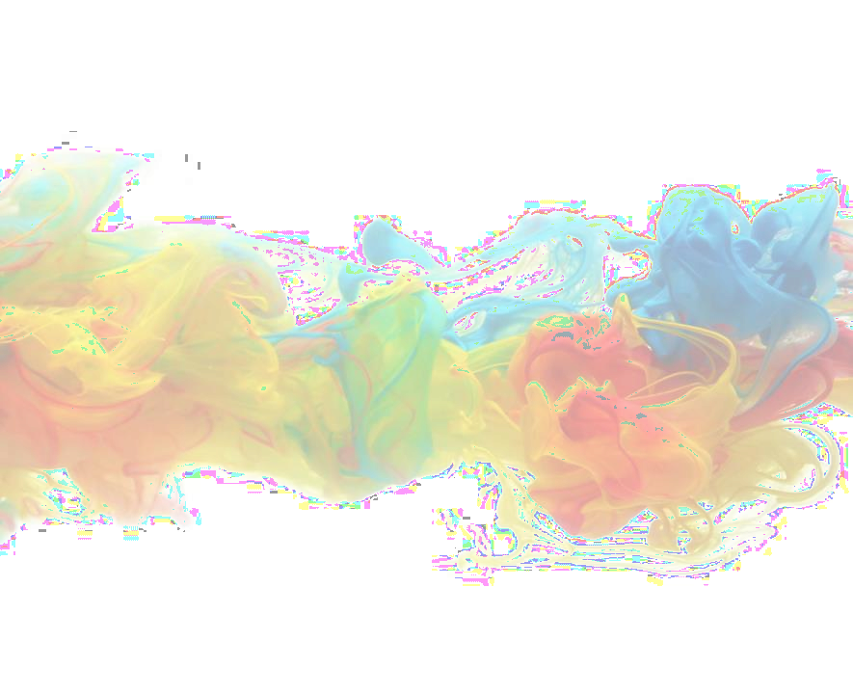

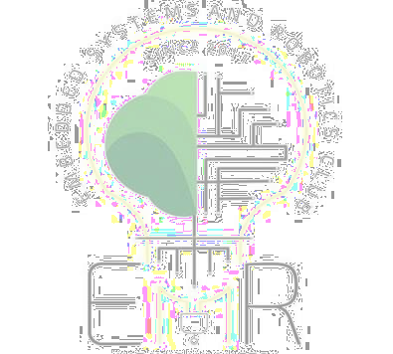
Introduction to OpenCV
By Embedded Systems and Robotics Club

Slide 2
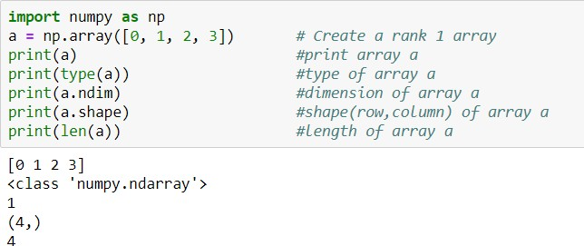
Basics of Numpy
In python, we do not have built-in support for the array data type. We can create intrinsic numpy arrays like arrange, ones, zeros, etc.
Array Creation: Numpy provides us with several built-in functions to create and work with arrays from scratch. A typical numpy array function for creating an array looks something like this:

Slide 3
Array functions
empty_array = np.empty([2,2], dtype = int) #creates an array with random values
zeros_array = np.zeros([2,2], dtype = int) # creates an array with all zeros
Identity=np.eye(3) #3X3 identity matrix
np.reshape(a,4) #reshaping array
<Array_name>.T #Transpose
Concatenation:
Example:
import numpy as np
a = np.array([[1, 2], [3, 4]]) b = np.array([[5, 6]])
print ("concatenated array vertically:", np.concatenate((a, b), axis=0))
print ("concatenated array horizontally:", np.concatenate((a, b), axis=None))

Slide 4
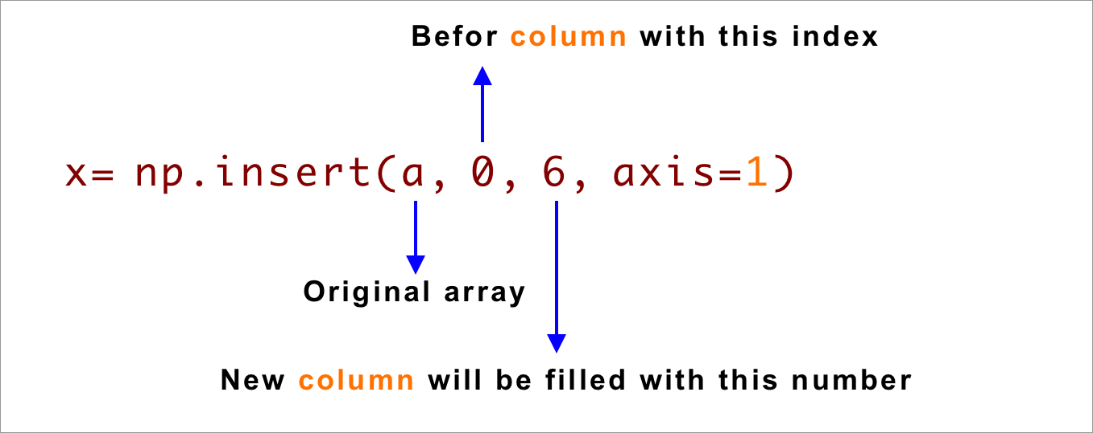
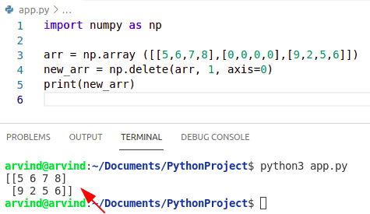
Array functions
Insertion
Deletion

Slide 5
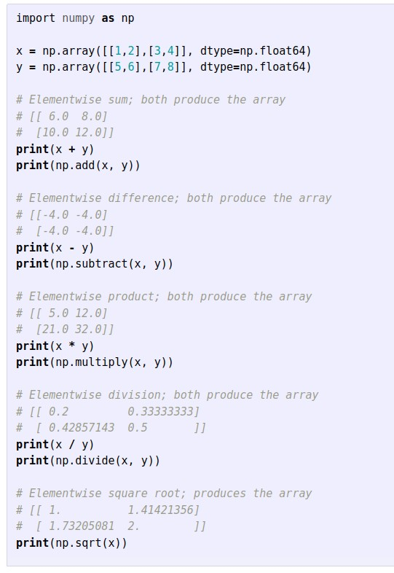
Array Math

Slide 6
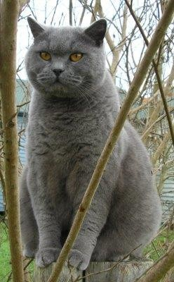
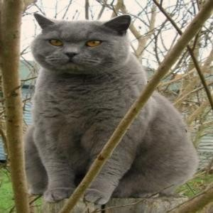
Why? Array for images
Actually , an image is an array, or a matrix, of square pixels (picture elements) arranged in columns and rows.
Example :-
img = imread('assets/cat.jpg') print(img.dtype, img.shape)
img_tinted = imresize(img_tinted, (300, 300))
img_tinted = img * [1, 0.95, 0.9] imsave('assets/cat_tinted.jpg', img_tinted)
Modified Image : Resized and contrasted
Original Image

Slide 7
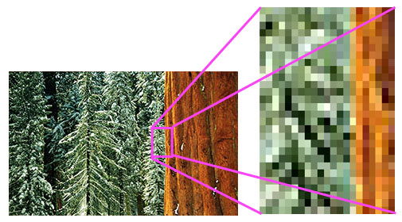
What is an image ?
An Image is just a 2D function f(x,y) where x and y are the horizontal and vertical coordinates of a pixel and f is the intensity of that pixel.

Slide 8
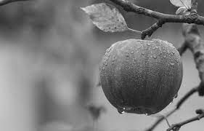
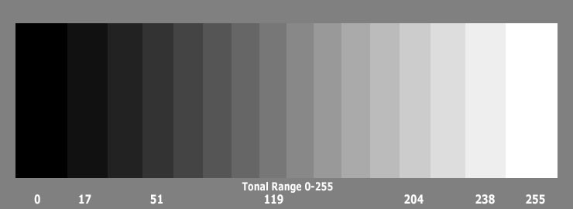
Grayscale images
Each pixel having only one number representing the intensity of gray.
For an 8 bit image Intensity range -> [0,255]
0 -> black
255 -> white

Slide 9
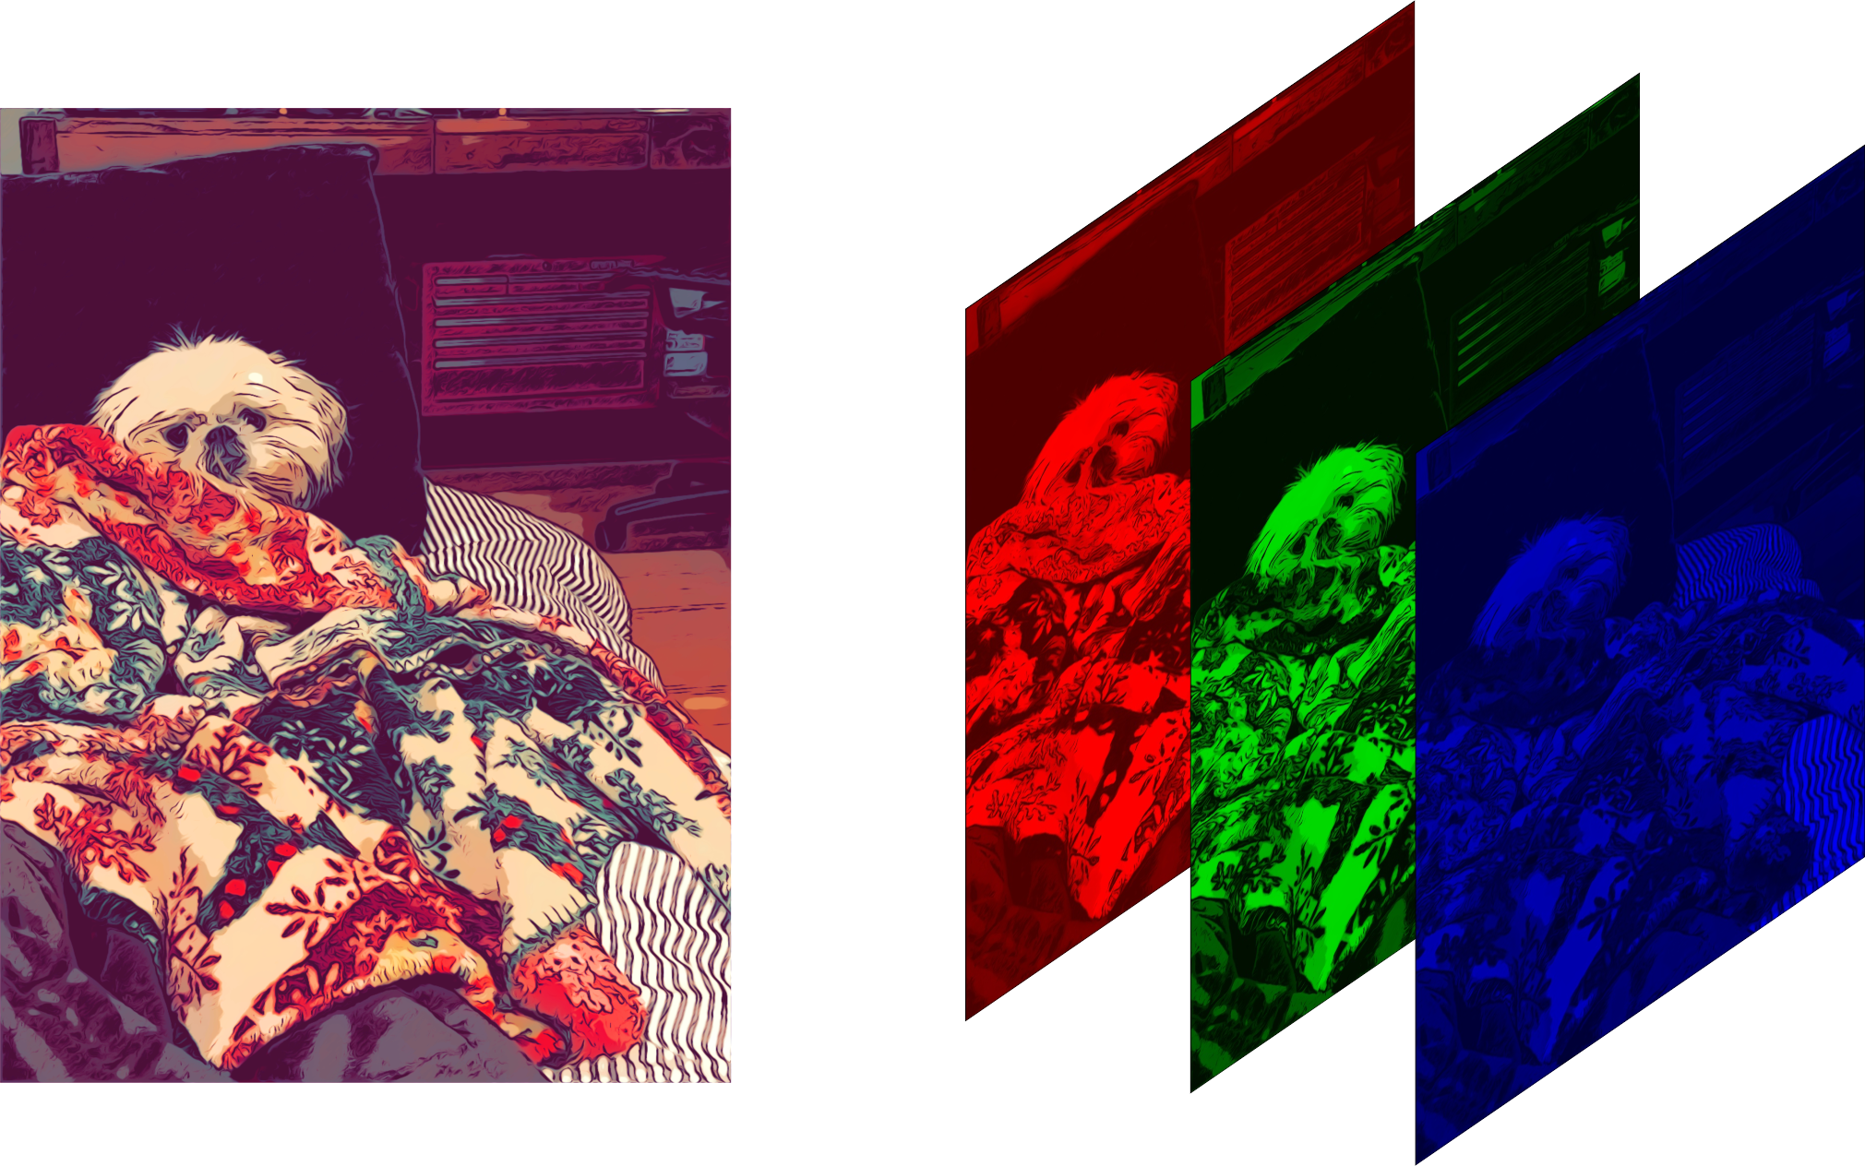
RGB Images
Image formed by addition of different intensities of red, blue and green components at every pixel.

Slide 10
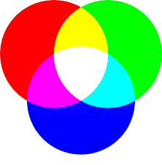
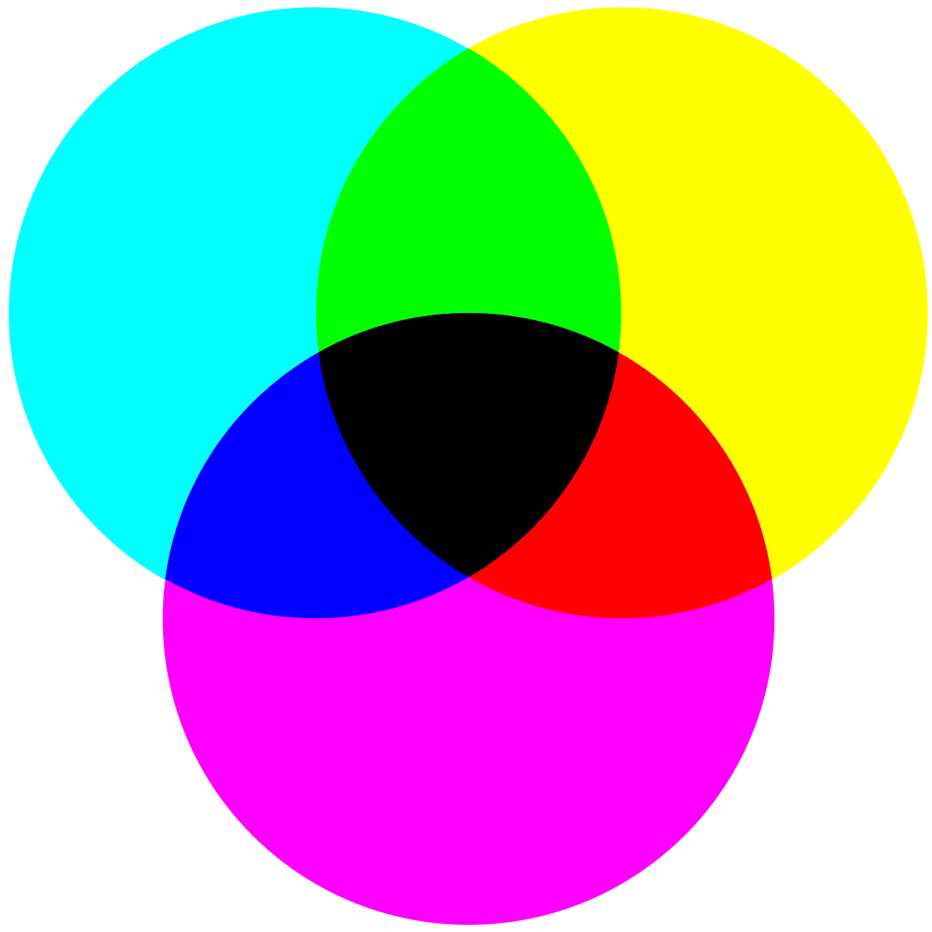
CMY Color Model
RGB Model
CMYK Model

Slide 11
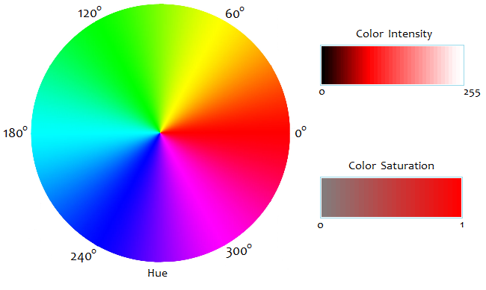
HSV (HSI) Color Model

Slide 12
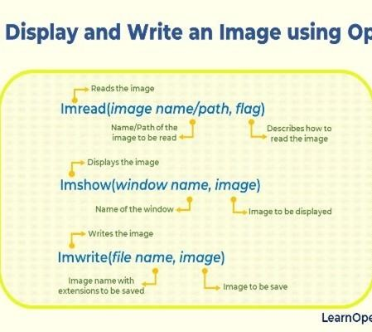
Reading an image
cv2.imread()
cv2.imread_color
cv2.imread_grayscale
cv2.imread_unchanged
Instead of these three ﬂags, you can simply pass integers 1, 0 or -1 respectively, with imread function.

Slide 13
CODE
In GRAYSCALE.. FLAG=0
import cv2 img0=cv2.imread("C:/Users/Vaishali/Desktop/kakashi.jpg",0) print("image has been read")
In BGR.. FLAG>0
import cv2 img1=cv2.imread("C:/Users/Vaishali/Desktop/kakashi.jpg",1)
print("image has been read")
Unchanged.. FLAG<0
import cv2 img2=cv2.imread("C:/Users/Vaishali/Desktop/kakashi.jpg",1)
print("image has been read")

Slide 14
Display an Image
cv2.imshow()
Arguments:
FRAME,IMAGE_NAME.
Pseudocode: cv2.imshow("Emr",img)
Name of frame in which img image will appear

Slide 15
Save an Image
Display an Image
cv2.imshow()
cv2.imwrite
Arguments: IMAGE,SAVEAS_IMAGE_NAME.
Pseudocode: cv2.imwrite(‘Emr.jpg',img0)
Arguments:
FRAME,IMAGE_NAME.
Pseudocode: cv2.imshow("Emr",img)
Name of frame in which img image will appear

Slide 16
waitkey
cv2.waitKey(milliseconds)
The function waits for speciﬁed milliseconds for any keyboard event. If you press any key in that time, the program continues. If 0 is passed, it waits indeﬁnitely for a key stroke. It can also be set to detect speciﬁc key strokes like, if key a is pressed
cv2.destroyAllWindows() :simply destroys all the windows we created. If you want to destroy any speciﬁc window, use the function
cv2.destroyWindow(image) where you pass the exact window name as the argument.

Slide 17
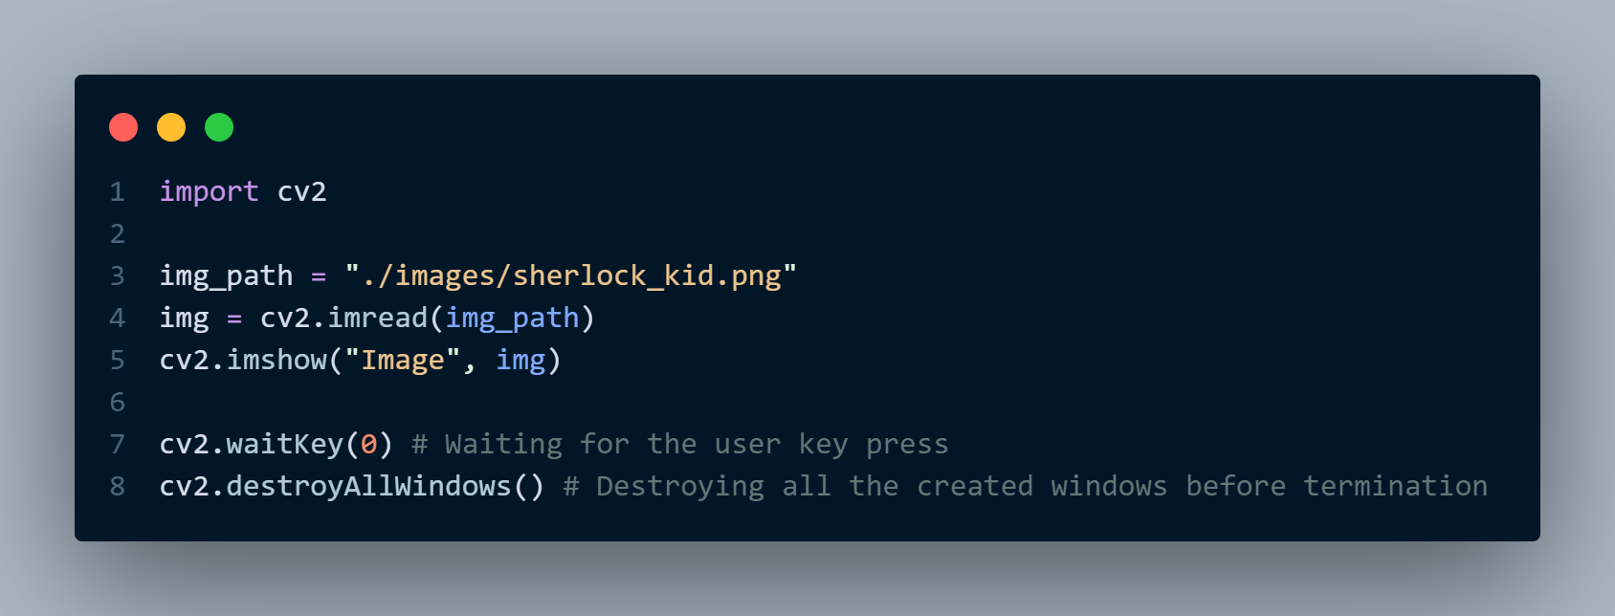
Reading Images (Code)

Slide 18
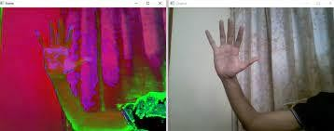
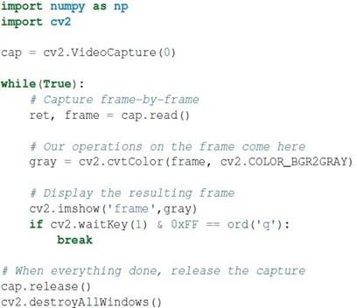
Capturing a video

Slide 19
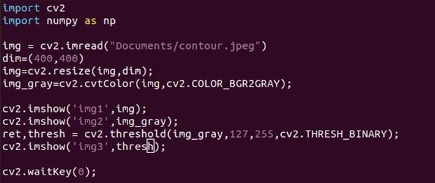
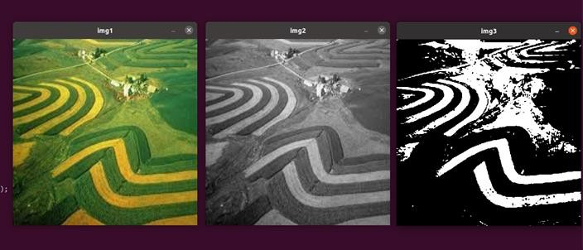
Color formats of an Image

Slide 20
Thresholding
Image thresholding is a simple form of image segmentation. It is a way to create a binary image from a grayscale or full-colour image. This is typically done in order to separate "object" or foreground pixels from background pixels to aid in image processing.

Slide 21
cv2.threshold(src, thresh, maxval, type)
Parameters:
src: input image
thresh: threshold value.
maxval: maximum value to use with the THRESH_BINARY and THRESH_BINARY_INV thresholding types.
type: thresholding type.
Returns:
Thresh, thresh_img: threshold value and thresholded image.

Slide 22
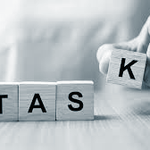
Task
Try to apply thresholding without using cv2.threshold() function?

Slide 23
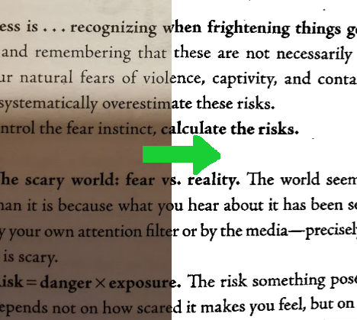
B&W filter using thresholding

